Slide 1

A Brief Introduction into Python
Week 1 of 3

Slide 2

Overview
Anaconda & IDES
Spyder & Jupyter Notebooks
Data Types in Python
Basic Mathematic Operators & Functions
Libraries and Packages
NumPy, SciPy, Matplotlib

Slide 3
Anaconda & IDES

Slide 4

LET’s Download anaconda
What’s Anaconda?
Open-source distributor for python/R-IDEs
What’s an IDE?
Integrated Development Environment
Notes:
https://www.anaconda.com/download/success

Slide 5

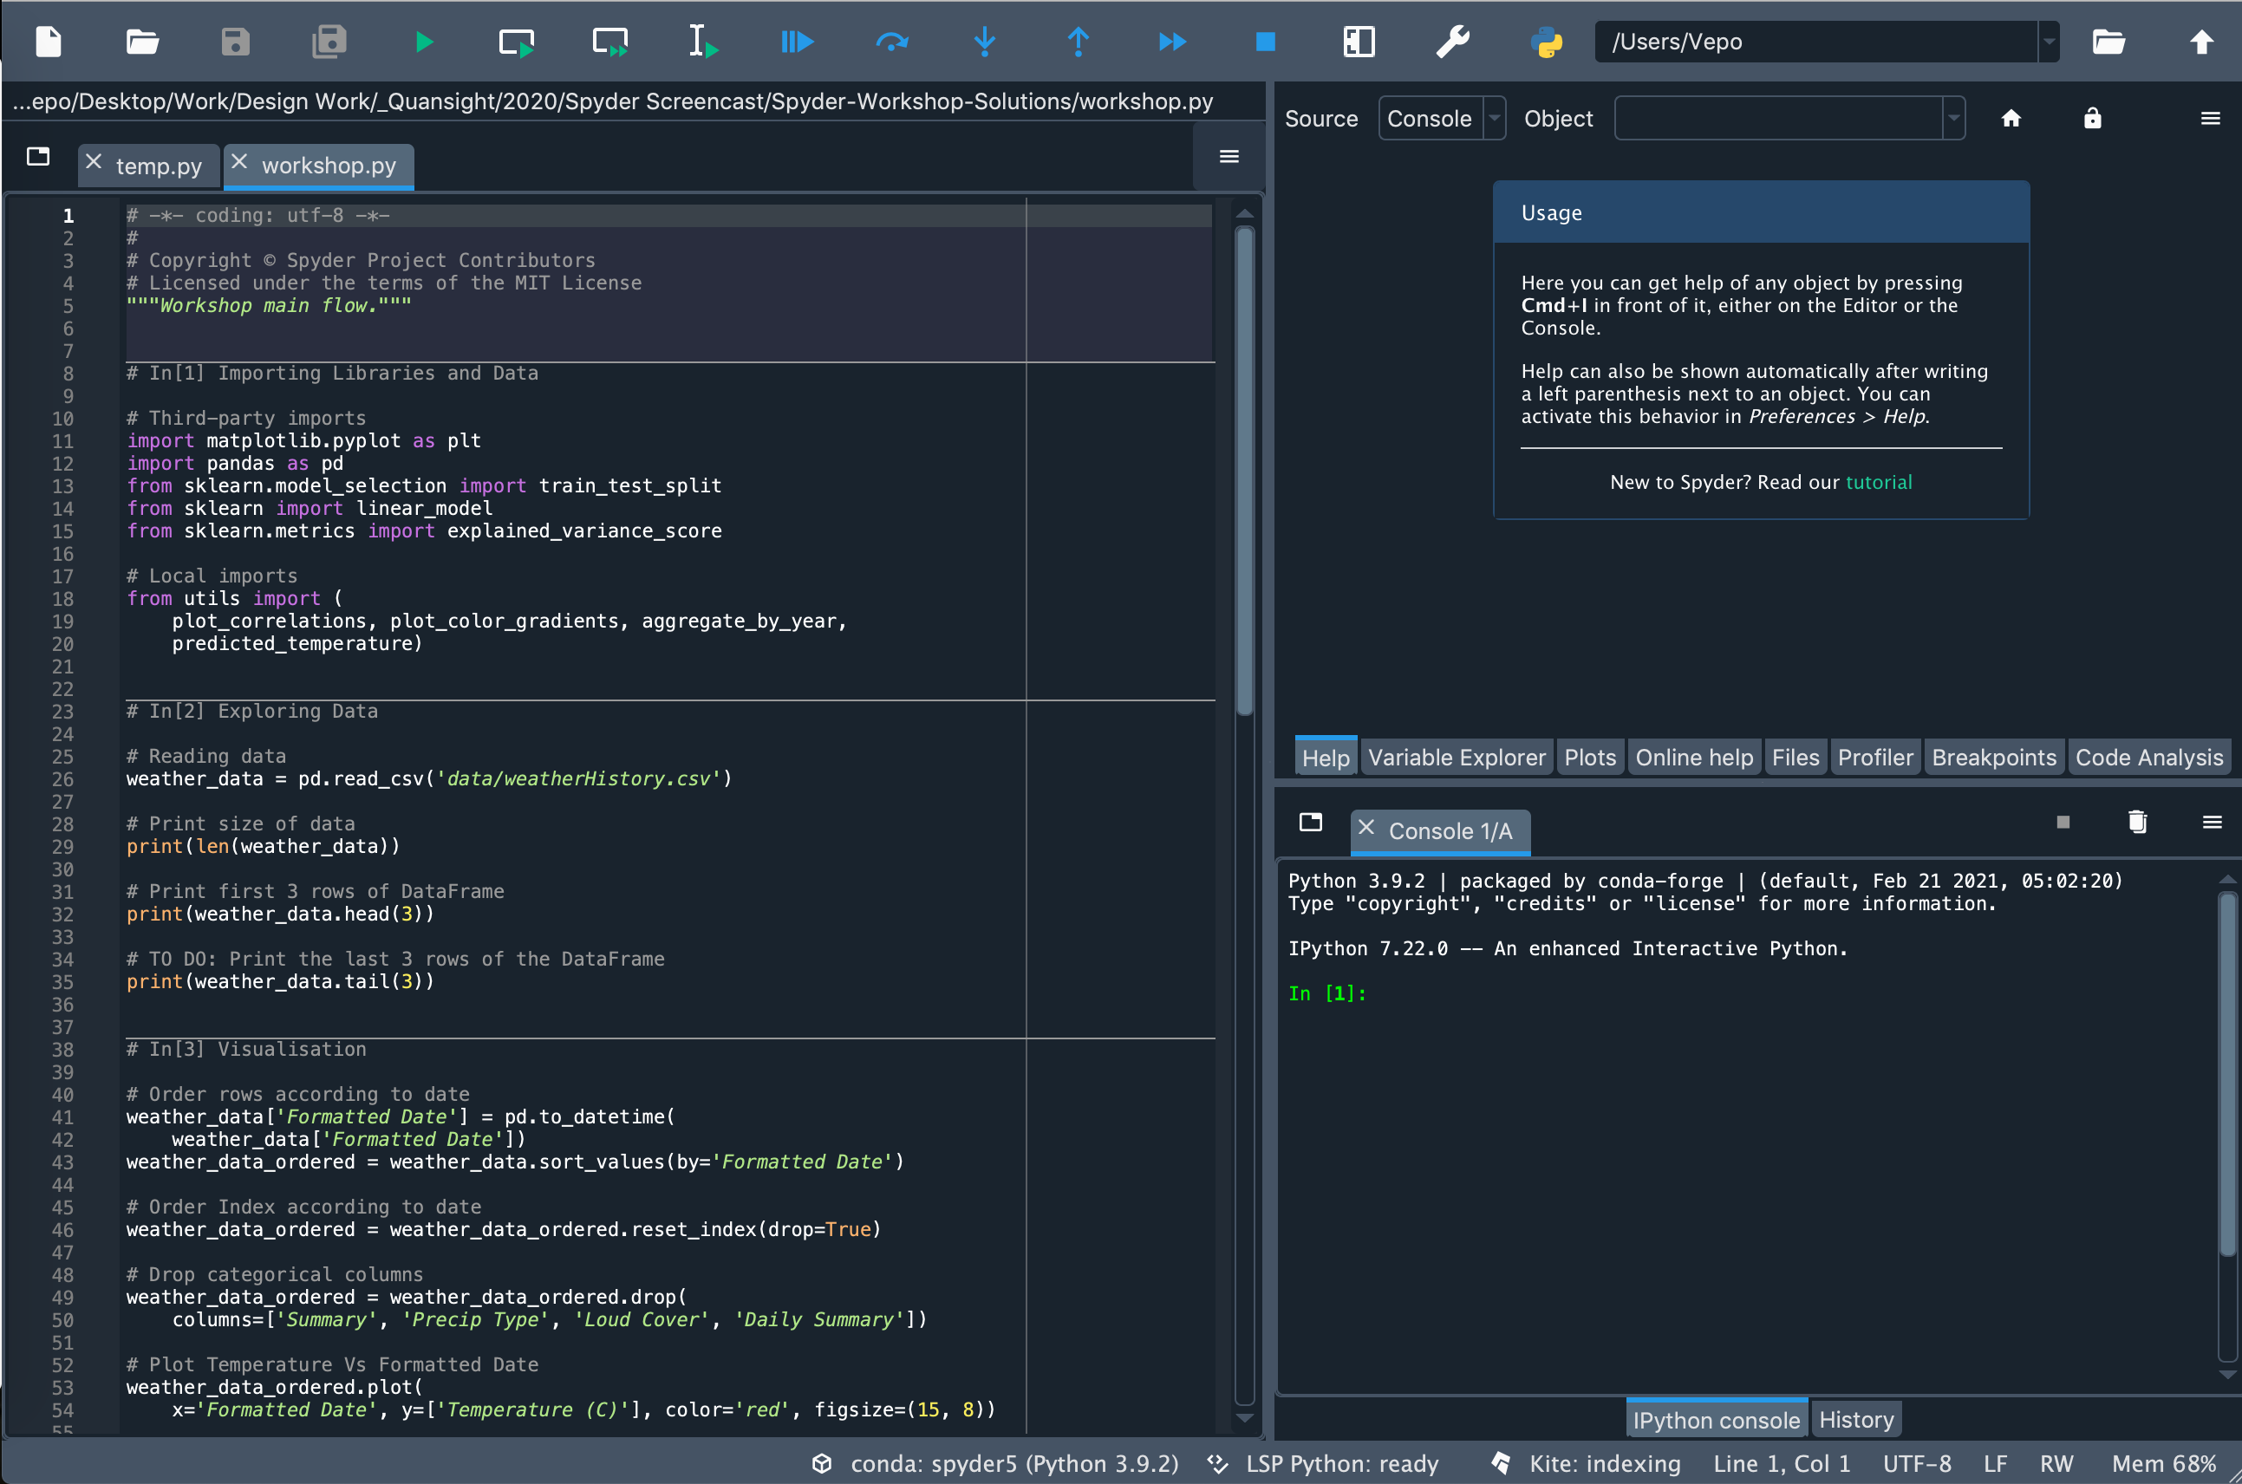
An IDE
Best formatted for writing “.py” scripts and testing them out
Variable Viewer and Directory Viewer
Variable Viewer/
File Explorer
Code Editor
Console/
Command Line

Slide 6

Jupyter Notebooks
Interactive Python Editor
Can write basic “.py” scripts and notebooks “.ipynb”
Annotate Notebooks

Slide 7
We’re using Jupyter notebook today!

Slide 8

Launch Jupyter Notebook

Slide 9
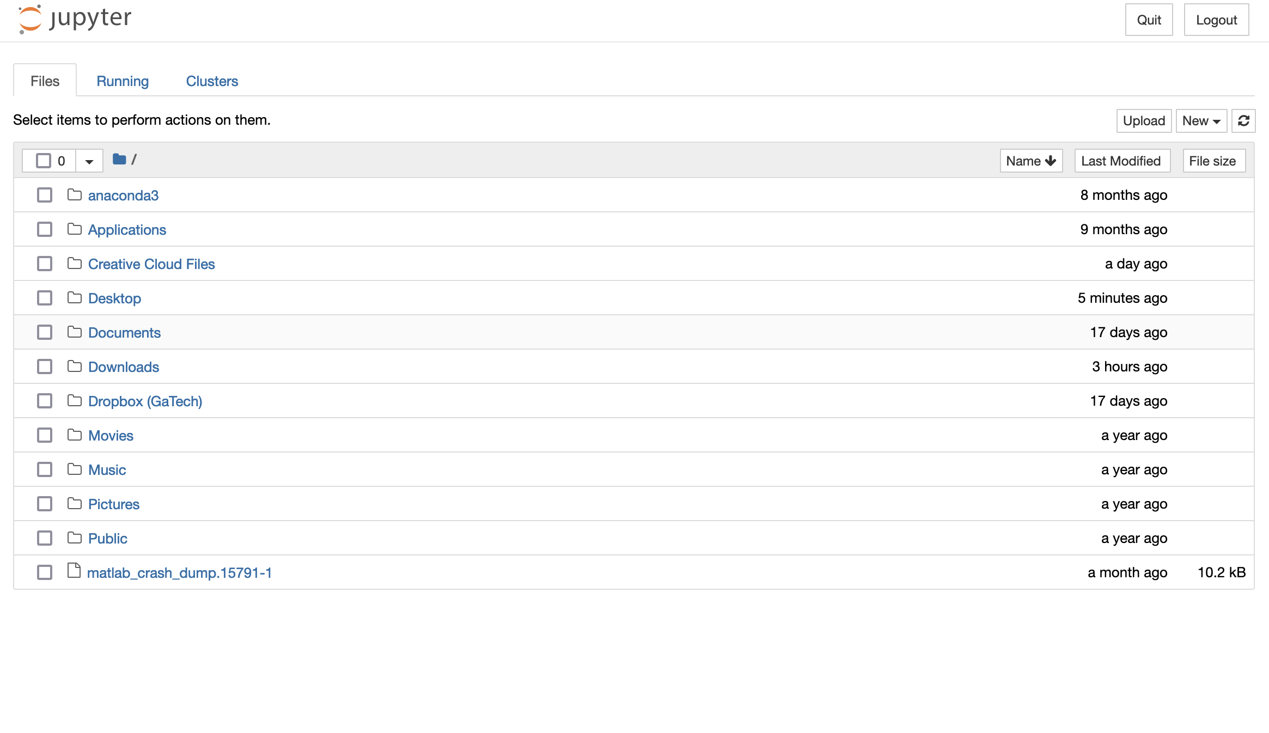
Creating a new Notebook

Slide 10
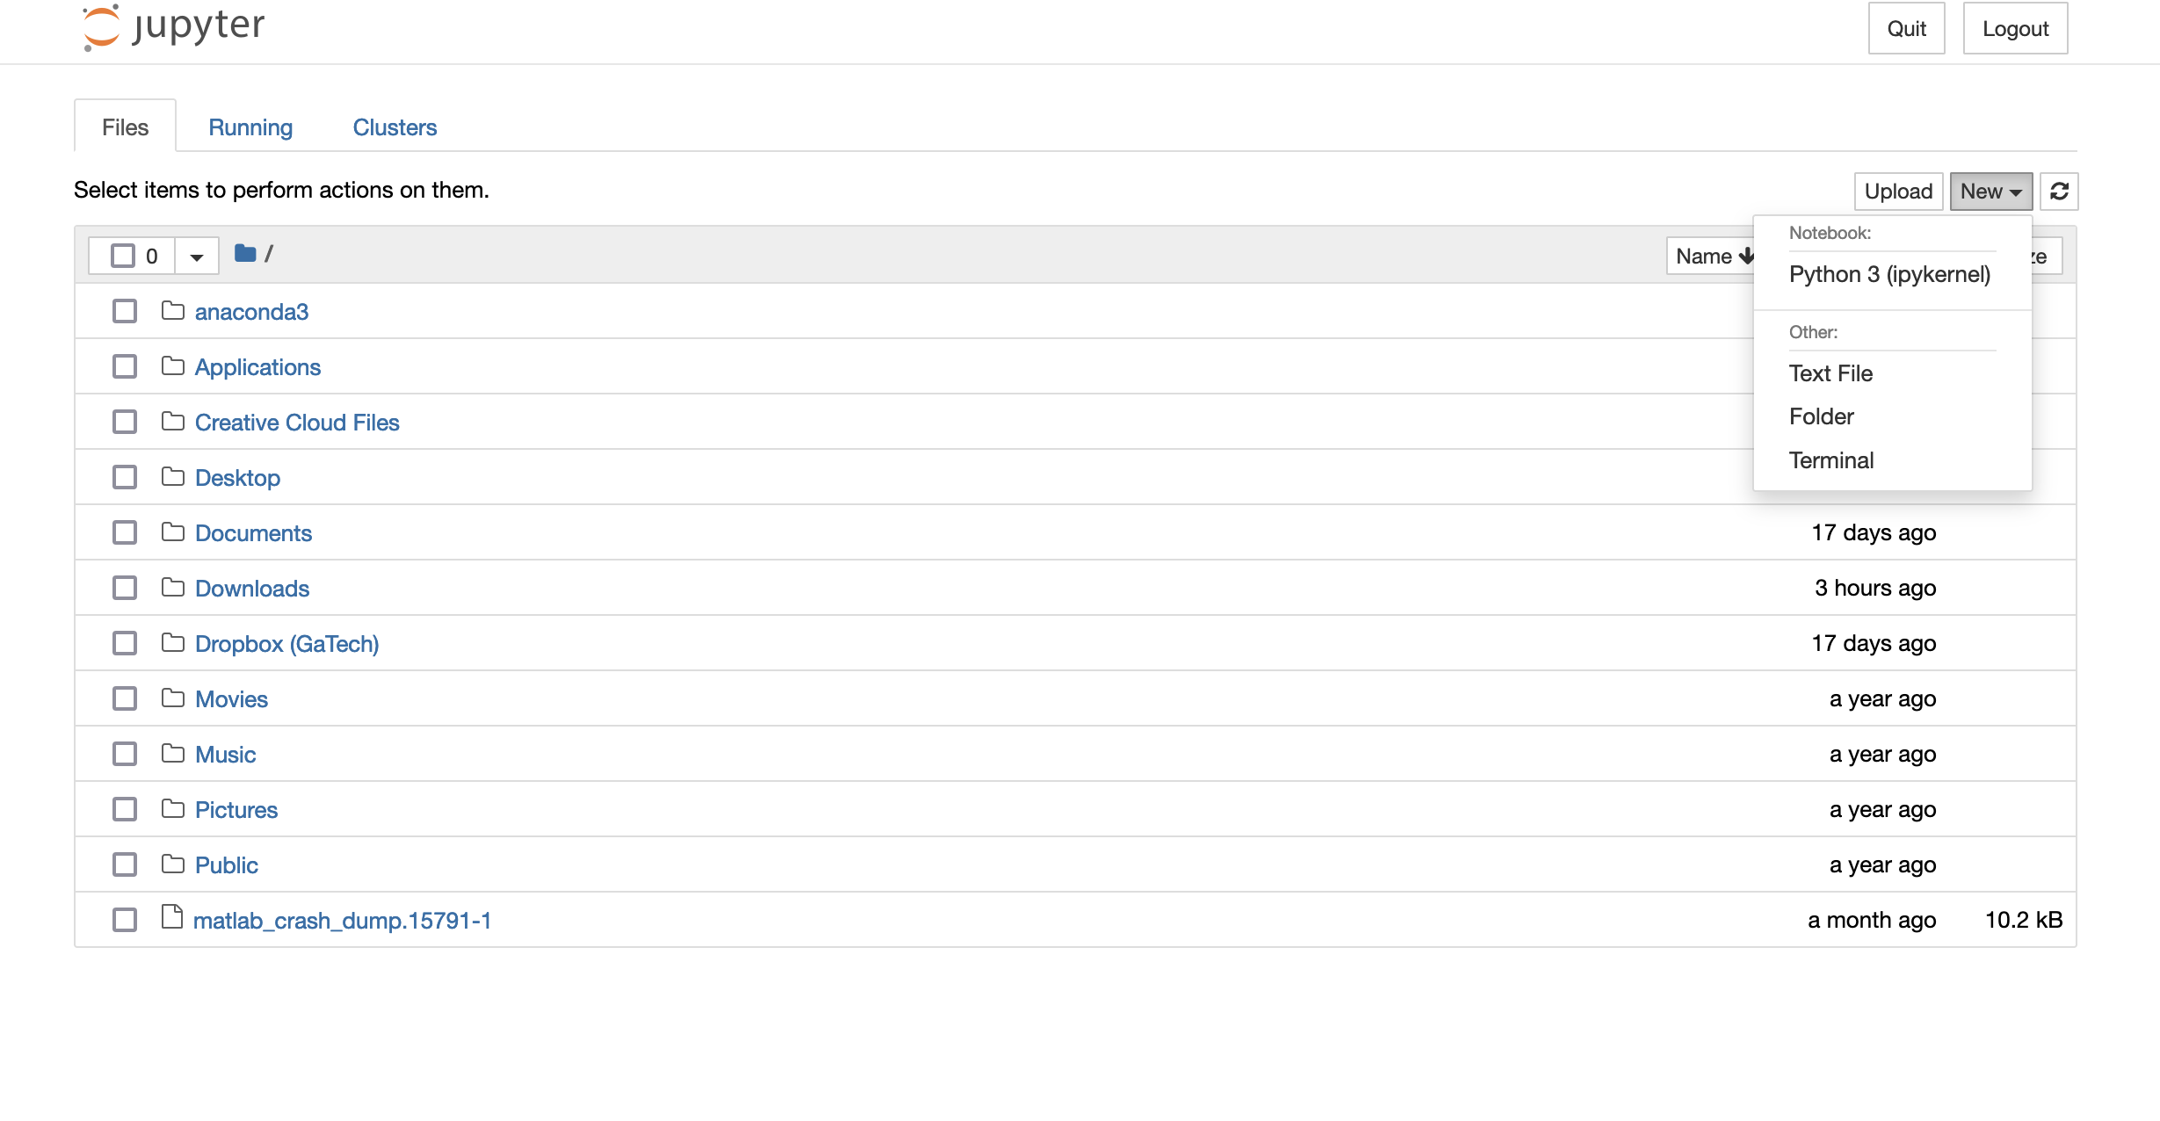
Creating a new Notebook

Slide 11
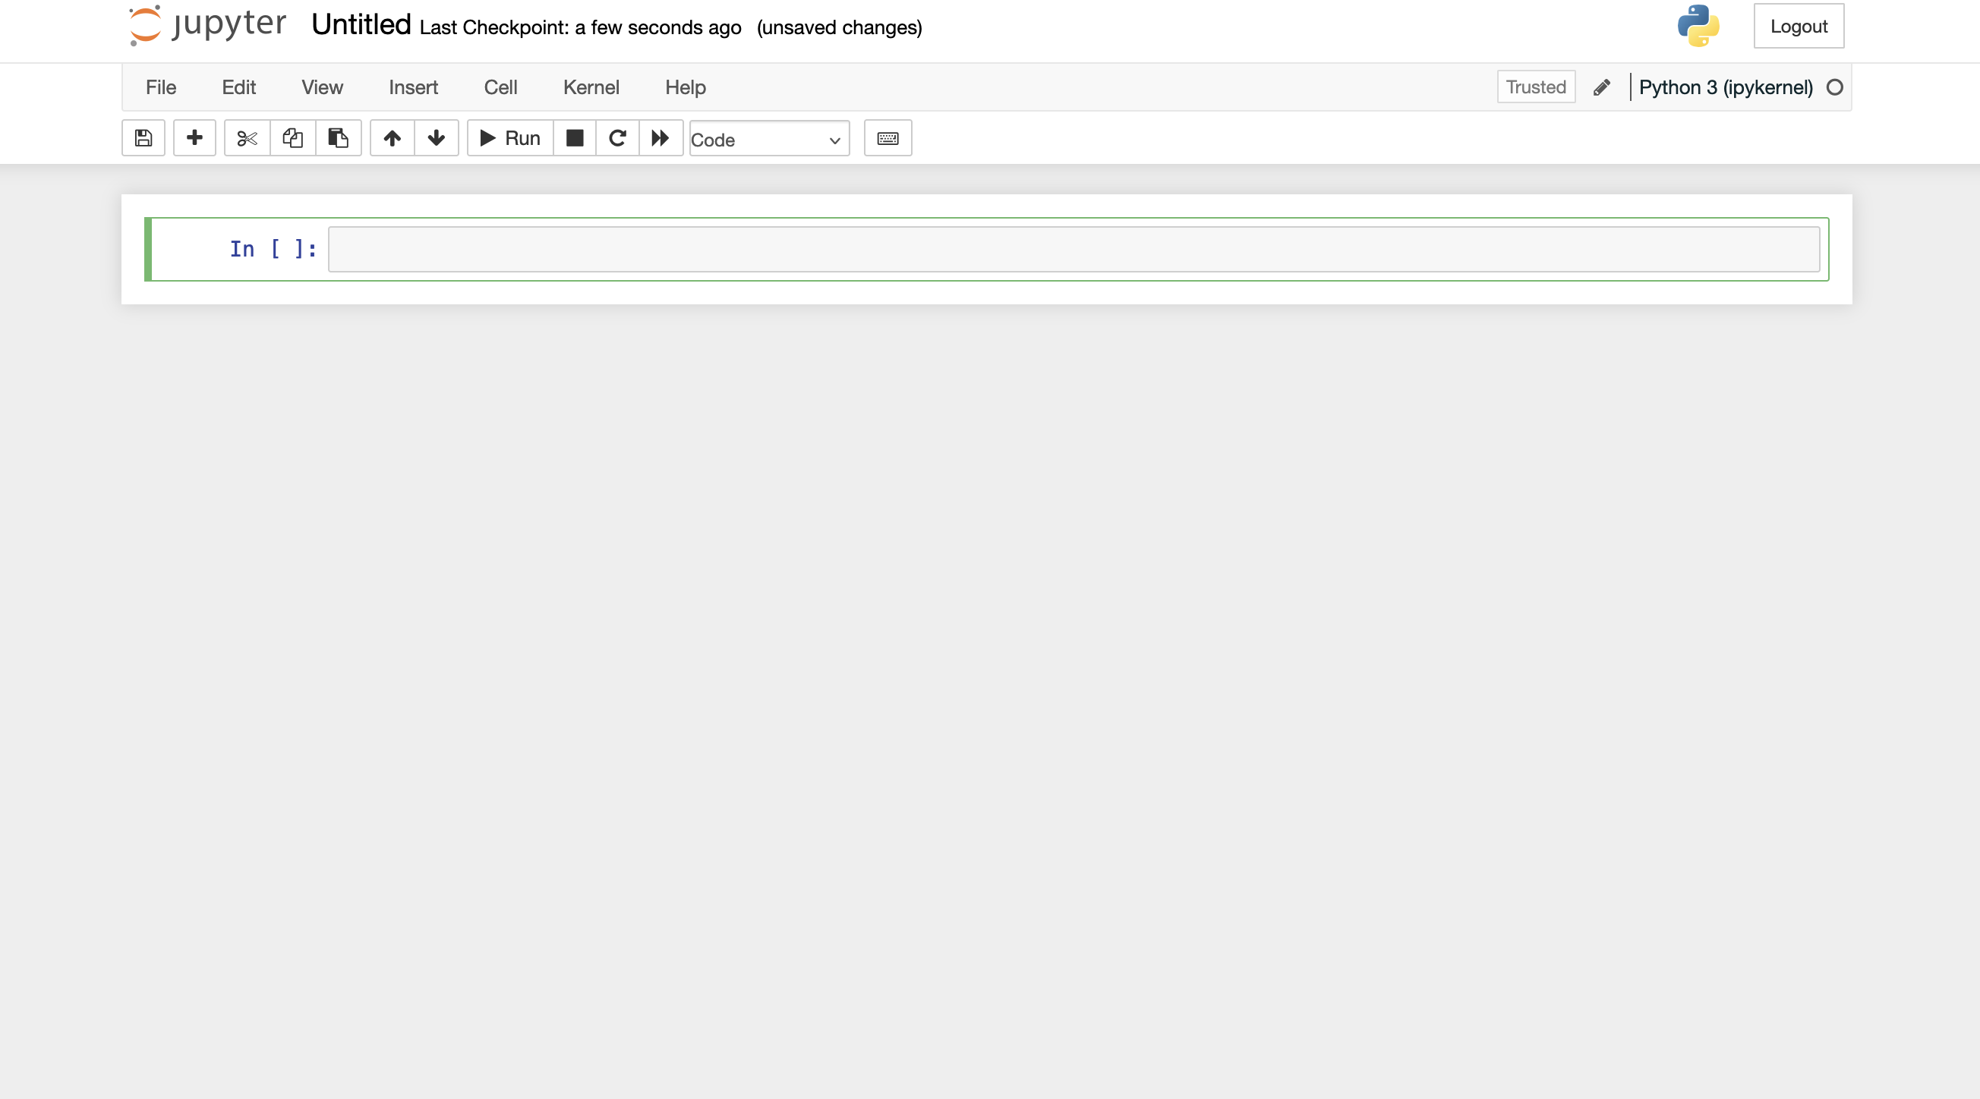
New Notebook is made!

Slide 12
Notebook Shortcut Bar Buttons
Edit Notebook Name
Execute code in current cell
Restart Kernel
Move cell above prior cell
Cell Type
Stop code running & Restart Kernel
Add a new cell
Copy selected cell
Stop (kill) code in running current cell
Move cell below succeeding cell
Save notebook
Deleted selected cell
Paste copied cell

Slide 13

Some python vocab
Kernel: Code interpreter that executes code in Jupyter notebook cell line by line
Console: Command line interpreter that executes code from scripts line by line
Variable: a reserved memory location to store data/values
Object: A variable that contains data or functions the can be used to manipulate data
Element: Items/Values inside a list, array, matrix, etc.

Slide 14
Data types in python

Slide 15
Data categories
Numeric
String
List
Boolean
Dictionary

Slide 16
numeric
Integer: 1, 1000, 786
Float: 0.87, 0.3333, 1.4
Complex: 8j, 5+ 2j, 80.0j

Slide 17
String
Declared using “double quotations” or ‘single quotations’:
“Hello World”
”1+2”
’There are 8 cookies’

Slide 18
List
An ordered collection of values
1-D horizontal vector/array
Denoted with square brackets []
Examples:
[0, “eleven”, 0.4, 8]
[1, 5, 9, 13]

Slide 19
Boolean
Logical Data Type
Only two possible outputs: True or False
Dictionary
Unordered collection of Data Values
Uses Curly Brackets {}
Syntax: {“Key”: Value}

Slide 20
Basic Python Operators & Functions

Slide 21
Declaring a Variable
Python is object-orientated programming language
Variables are such an object
Variables store data
Syntax: varname = data
Naming Rules:
No Spaces (Use an _ instead!)
Variable Name cannot start with a number
No special symbols

Slide 22
Built-in functions
len(): Returns the length of the variable
type(): Returns the data-type of a variable
print(): Returns the value of a variable
float(): Returns variable as a float (input types: integer or string only)
int(): Returns variable as an integer
str(): Returns variable as a string
bool(): returns variables as a Boolean
Returns False when fed 0
Returns True for everything else

Slide 23
Mathematical Operators
Addition: +
Subtraction: -
Multiplication: *
Division: /
Exponent: **

Slide 24
Logical Operators
Greater than: >
Less than: >
Greater than or equal to: >=
Less than or equal to: <=
Equal to: ==

Slide 25
Other functions
Comment: Placing a # in a line causes what followed to be commented out
Cells: #%% creates a new cell (not applicable for Jupyter notebooks)
Comment Blocks: Placing ‘’’ above and below a block of code comments out the entire block
max(): Returns the element with the largest value in a list
min(): Returns the element with the smallest value in a list

Slide 26
Python packages and libraries

Slide 27
Libraries & Packages
Libraries and Packages are external code you load to simplify your own script
At the beginning of every script, you should load any libraries and packages you need
Most used: NumPy, Matplotlib, & SciPy
Built into Anaconda (Full list here)
Syntax
import package_name as shortcut_name
Ex.: import numpy as np
Let’s try loading these in our notebook!

Slide 28

Always import packages and libraries first
First part of writing a python script is to import the necessary packages and libraries you will be using in your script.

Slide 29


Numerical Computing Library
Introduces new data type ”numpy array”
Arrays are the better list
They can be multidimensional
Stores objects or “nested” sequences
Syntax: np.array([data])

Slide 30
Other numpy array functions
np.ones (shape): returns an array of ones of given shape/size
np.zeros (shape): returns an array of zeros of given shape/size
np.linspace(start,stop,length): returns array of size length from start to stop
np.arrange(start,stop,step): returns array from start to stop with step interval size between each element

Slide 31
Quick indexing tutorial
What is indexing? Allow you to call an element of an array of list
To call a specific element of a list or array
Uses square brackets [] with position of element
Syntax: object[index]
Python starts counting at 0

Slide 32
Indexing syntax
Calling a single element: variable[element position]
Calling several element values: variable[start:stop:step]
If you leave step blank it assumes step=1
Element position must be a WHOLE number
Using a negative number reverses the order of list or array Starts from the end -> start

Slide 33

Indexing Strings
You can index strings!
It counts the characters within the string like elements of a list or array
You can “splice” a string and it will return a string with only those characters
Example:
Var = “Hello World”
Var[1:5] -> “ello”
Note: Splice will cutoff at element before stated end point

Slide 34
Mathematical functions of numpy

Slide 35
Simple math functions of numpy
np.round( input, decimal places): rounds input to the decimal place indication
np.sum(input): sums all the elements in an object
np.sqrt(input): takes the square root of an object
np.exp(input): calculates the exponential (e^{input}) of an object
np.log(input): take the natural logarithm (ln) of the input
np.log10(input): takes the logarithm with base 10 (log₁₀) of the input
np.log2(input): takes the logarithm with base 2 (log₂) of the input
np.abs(input): takes the absolute value of the input

Slide 36
Trigonometric functions of numpy
np.degrees(input): converts input from radians to degrees Identical function: np.rad2deg()
np.radians(input): converts input from degrees to radians Identical function: np.deg2rad()
np.sin(input): takes the sine of the input np.arcsin(input): takes the inverse sine of the input
np.cos(input): takes the cosine of the input np.arccos(input): takes the inverse cosine of the input
np.tan(input): takes the tangent of the input np.arctan(input): takes the inverse tangent of the input

Slide 37
Statistical functions of numpy
np.max(input): returns the maximum value of the input object
np.min(input): returns the minimum value of the input object
np.median(input): returns the median of an object
np.mean(input): returns the mean of an object
np.average(input): returns the weighted average of an object
np.std(input): returns the standard deviation of an object
np.var(input): returns the variance of an object
np.histogram(input): returns the histogram of an object

Slide 38
Mathematical constants in numpy

Slide 39

Mathematical constants in numpy
Pi (π): np.pi
Infinity (∞): np.inf
Negative infinity (-∞): np.ninf
Euler’s constant (e): np.e
Not a Number (nan): np.nan

Slide 40


Comprehensive library for creating static, animated, and interactive visualizations in Python
It’s the most used plot maker in Python
Other plotting packages and libraries typically have some dependency on Matplotlib
Pyplot is most common package
Import Matplotlib as:
import matplotlib.pyplot as plt

Slide 41
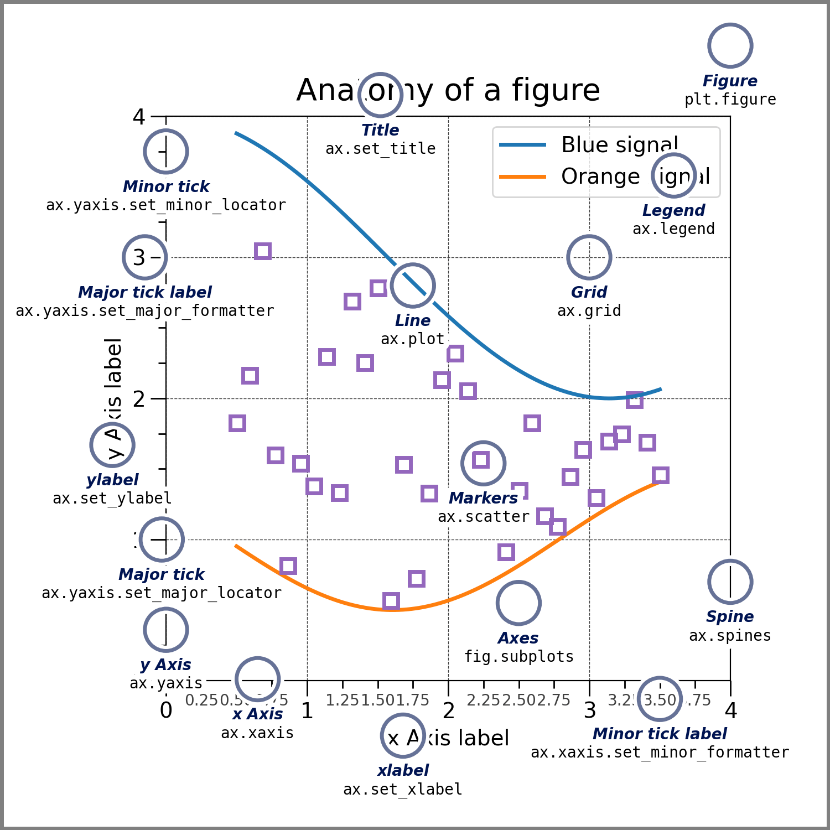
Getting Started
Make sure your lists/arrays are the same length (have the same number of elements)
Always begin a new plot with creating a new Figure
Figure: blank window which plots/ subplots are displayed on
You overlap plots in a single Figure
You can put multiple plots in a single figure with subplots
To create a new figure use plt.figure()

Slide 42
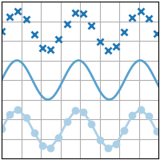
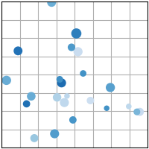
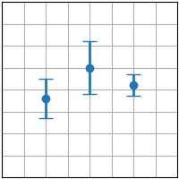
Common 2d plots
plt.plot(x,y)
plt.scatter(x,y)
plt.errorbar(x,y,xerror,yerror)

Slide 43
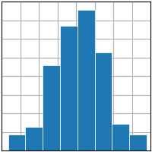
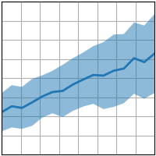
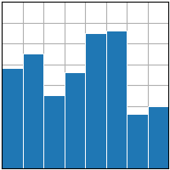
Other important plot types
plt.hist(x)
plt.fill_between(x,y₁,y₂)
plt.bar(x,y)

Slide 44
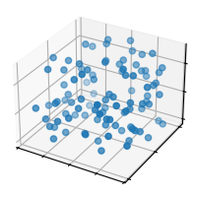
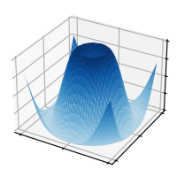

Some 3d Dimensional Plots
plt.scatter(x,y,z)
plt.plot_surf(x,y,z)
plt.contourf(x,y,z)

Slide 45

Customize Plots
There are a wide arrange of colors and markers you can use to customize your plot
You can also add labels to the vertical and horizontal axes X-axis: plt.xlabel(“String Input”) & Y-axis: plt.ylabel(“String Input”)
You can title your plot with the following function: plt.title(“Sttring Input”)
All label and titles require a string as a minimum input There are customizations for font, font size, super/subscripts, symbols, etc.
For multiple sets of data in a single plot window, you can add a label within the specific plot function you call (Ex. plt.plot(x,y,label=“string”)) and place a legend (plt.legend()) on the plot

Slide 46
Let’s try creating a plot in Jupyter notebook

Slide 47
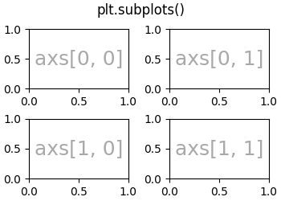
subplots
You can add multiple plot windows in the same figure using plt.subplots(# rows, #columns)
The function gives two outputs a figure and axes object
it can be a singular variable or an array of variable for each subplot

Slide 48
Let’s make a figure of subplots in Jupyter notebooks

Slide 49

Customizing subplots
Customizations can be made to each individual plot in a subplot figure
For each axes variable output from plt.subplots, you are able perform the same customizations as the plt.plot
Syntax: axes_var.set_customization
Let’s try a few in Jupyter Notebook

Slide 50

Library for scientific computing built from NumPy
Used primarily to solve mathematical and scientific problems
Capable of performing integration, linear algebra, solving ODEs, signal processing, etc.
We’ll learn more about SciPy during Week 3 in some Data Processing

Slide 51

Week 1

Slide 52



A good chunk of coding is googling. Google and stack overflow are your best friends

Slide 53
supplemental

Slide 54

Keyboard Shortcuts
Shift+Enter: to run
Control+/: Comment/Uncomment current line
Package/library Shortcut.Tab: to see list of functions in a package
Tab: Autocompletes variable names and function names

